Slide 1
RHEUMATIC FEVER – CURRENT CONCEPTS
Guidelines, Diagnosis & Therapy
Dr. Dayasagar Rao
DM (Cardiology)
FRCP (Canada), FRCP (Edinburgh)
Senior Consultant Cardiologist
KIMS Hospital
Hyderabad, Telangana
Notes:
1

Slide 2
INTRODUCTION
Acute rheumatic fever - nonsuppurative, immunologically mediated, inflammatory disease, affecting multiple organs
Caused by GABHS
Latent period : 2 – 6 weeks
Pathological basis : Molecular mimicry
Sharing of common antigen of GABHS and human tissues
Antibodies against the GABHS cross-react with human tissues
Notes:
2

Slide 3
EPIDEMIOLOGY
Usually occurs in people between 5 – 15 years
Overcrowding, poverty, lack of access to medical care contributes to transmission
Virulence of the strain and host susceptibility are important determinants
Notes:
3

Slide 4
RHEUMATIC FEVER & STREP THROAT
Strep infection leads to ARF
Incidence:
Sporadic : 0.3%
Epidemic: 3%
Virulence of the strep strain
Social environment
Genetic susceptibility
Notes:
4

Slide 5
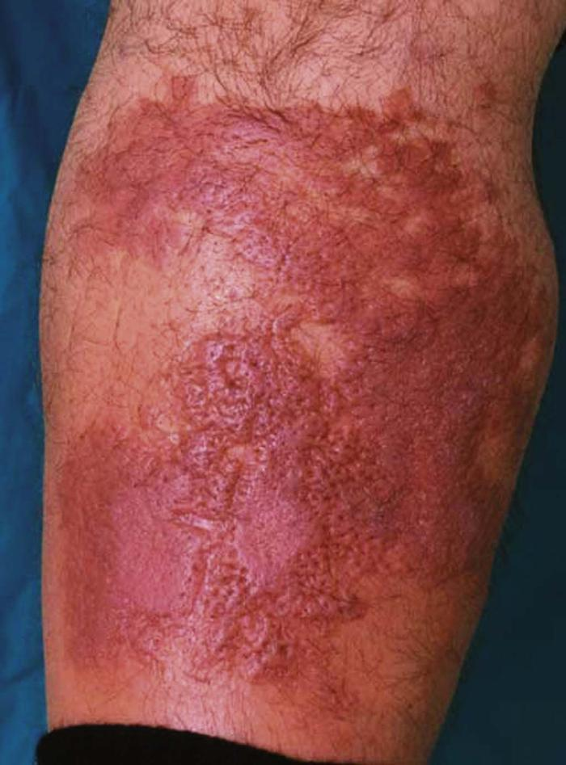
STREP INFECTION SKIN – RHEUMATIC FEVER
First suspected:
Australia – Aborigine population, 2002
Sore throat: Rare
Skin infection: High
New Zealand: Maori, Pasifka
Fiji Islands
High prevalence of Rheumatic fever
Low incidence of sore throat
High incidence of strep skin infection
Notes:
5

Slide 6
STREP SKIN INFECTION – RHEUMATIC FEVER
Therapy: Strep throat x 10 days
Skin infection – usually 5 days
Maybe caused in patients who do not give history of sore throat preceeding ARF
Evidence: “.... some forms of skin infection (due to strep A) are likely to cause Acute Rheumatic Fever.”
Notes:
6

Slide 7
ACUTE RHEUMATIC FEVER
ARF/RHD – Disease of poverty & overcrowding
Mean incidence worldwide: 19/100,000 school children
Lower in developed countries
Highest in :
Aborgines – Australia
Maori – New Zealand
(150-380/100,000 children 5-14 years)
India: 100-200/100,000 school children (5-18 years)
Notes:
7

Slide 8
ARF – OUTBREAKS – USA
Intermountain area of USA, Salt lake City, Utah (Jan 1986 – July 1986)
Children – Predominantly white (96%)
Middle class family
Above average income
Ready access to medical care
Carditis:
Ausculation: 72%
Echo doppler: 19%
Total Carditis: 91%
17% had symptomatic preceeding sore throat (seeking medical attention).
20% pure chorea (57% echo carditis)
NEJM 1987: 316 (8): 421, Veasy et al. J Ped 1994: 124(1):9
Notes:
8

Slide 9
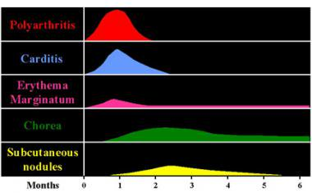
MAJOR MANIFESTATIONS – TIME COURSE
Notes:
9

Slide 10
MAJOR MANIFESTATIONS
67%
(DELHI)
33%
21%
2%
ARTHRITIS
CARDITIS
CHOREA
HEART FAILURE
Modified from: SK Sanyal et al. Circ 1974
Notes:
10

Slide 11
POLYARTHRITIS
Swelling, pain & restriction of movement involving ≥ 2 joints
66 – 75% patients
Most common & earliest manifestation
Migratory polyarthritis/additive polyarthritis
Involves large joints (knees, ankles, elbows, and wrists)
Notably does not involve the axial skeleton – spine, &, small joints

Slide 12
POLYARTHRITIS
History of rapid improvement with salicylates or NSAIDs is characteristic
Self-limited course, even without therapy, lasting ≈ 4 weeks
Absence of long term deformity – exception: Jaccoud’s arthropathy
Inverse relationship between severity of arthritis & cardiac involvement
SK Sanyal et al. Circ 1974

Slide 13
POLYARTHRALGIA
Joint pains +, but no local signs of inflammation
Very common, highly nonspecific manifestation of a number of rheumatologic disorders.
Children with polyarthralgia from HIGH risk zones – ARF to be considered
AHA 2015 Update to Jones Criteria:
Inclusion of polyarthralgia as a major manifestation is applicable only for moderate- or high-incidence populations and only after careful consideration and exclusion of other causes of arthralgia.
(Class IIb, LOE: C)

Slide 14
ASEPTIC MONOARTHRITIS
Studies from India, Australia, and Fiji:
Important for ARF in selected high-risk populations.
High risk indigenous Australian population:
Present in 16% to 18% of confirmed cases of ARF.
ARF to be considered in High Risk zones (AHA 2015 – Major criteria)

Slide 15
POST STREPTOCOCCAL REACTIVE ARTHRITIS
Shorter latent period (7 – 10 days)
Persistent/Relapsing
Slower response to aspirin
Symmetric involv of large, small joints & axial skeleton
Not associated with other major manifestations
Some patients with reactive arthritis developed RHD during followup
Secondary prophylaxis for 1 year after onset of symptoms in high-risk populations. (Class IIb, LOE: C)

Slide 16
JACCOUD’S ARTHROPATHY
Chronic post-rheumatic fever arthropathy
Severe RHD & not asso with evidence of RF
Recovery delayed / asso with MCP joint stiffness
Deformity due to –
periarticular, fascial, tendon fibrosis
Normal ESR, negative RA factor
Charac by flexion at MCP joint with ulnar dev of 4th & 5th fingers & hyperextension of PIP
Correctable & not assoc with bone destruction

Slide 17
CARDITIS
Most important manifestation of ARF
Residual sequele – RHD
Occurs in first 2 weeks of ARF
PAN-Carditis:
Endocardium
Myocardium
Epicardium
Frequency:
60-90%
Method of eval – clinical/echo doppler
First attack - recurrent

Slide 18
RHEUMATIC CARDITIS
Clinical Carditis
Subclinical Carditis (Echo Carditis)
Indolent Carditis
Recurrent Carditis
Notes:
18

Slide 19
CARDITIS
Symptoms
Tachycardia – out of proportion to fever
1⁰C → 10bpm
Auscultation – Regurgitation murmurs
MR/TR/AR
Echo-doppler: sub-clinical (echo carditis)

Slide 20
CARDITIS
92 – 95% : MV involvement
70 – 75% : Isolated MV
20 – 25% : Aortic valve involvement (along with MV)
5 – 8 % : Isolated AV
Involvement of TV : Rare (<10%)
Always along with MV
Involvement of all cardiac valves
Reported, but extremely rare

Slide 21
CARDITIS
Severity of carditis – clinical:
Cardiac murmurs
Cardiomegaly
CHF
Pericardial rub
Diagnostic/Therapeutic relevance
Long term prognosis on valvular status & CRHD
Mild carditis
Moderate carditis
Severe carditis

Slide 22
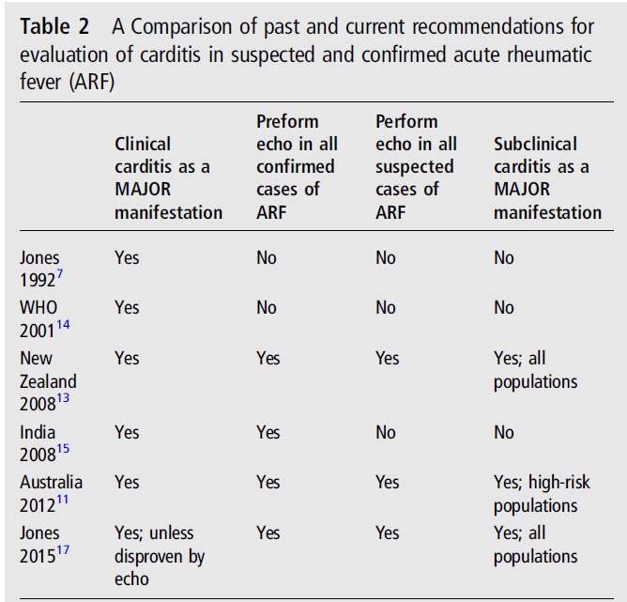
CARDITIS THROUGH THE YEARS
2015 AHA Update to Jones Criteria for diagnosis of RF. Circ 2015
Notes:
22

Slide 23
ARF – VALVULAR HEART DISEASE
Natural History:
Regression
Progression
Mitral valve – Aortic Valve
Influence by severity of carditis:
Severe Carditis – MR/CE/CHF – unlikely to regress

Slide 24
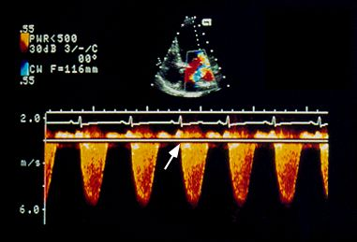
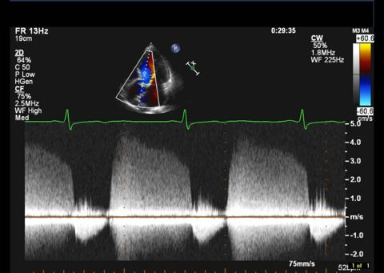
2015 AHA CRITERIA – ECHO CARDITIS

Slide 25
2015 AHA CRITERIA – ECHO CARDITIS

Slide 26
MV – Excess leaflet tip motion
Normal
RHD
MVP

Slide 27
MV – Normal vs Rheumatic
Normal
RHD

Slide 28
VIJAYA ECHO SCORE

Slide 29
ARF – Valvular Heart Disease
SK Sanyal et al. Circ 65 no. 2, Feb 1982

Slide 30
CARDITIS - SUBCLINICAL
Clinically silent
Echo – doppler: Valvular regurgitation
Reported prevalence : 0 – 53%
RF outbreaks –
USA Salt lake city, Utah : 17% (+74% clinical= 91% total)
Bihar, India 2017: 27% (+64% clinical = 91% total)
Int J Adv Med, Oct 2017, Suman S et al

Slide 31
INDOLENT CARDITIS
Evidence of Carditis:
Insidious onset
Slow progression (less aggressive)
Milder forms (asymptomatic/Mild symptoms)
Active inflammation
Not recognised/late recognition during routine check-up for incidental illness
Essential criteria NOT required – Late presentation
Notes:
31

Slide 32
RECURRENT CARDITIS
Established CRHD
Recurrance of ARF – Carditis
Onset of new cardiac murmur
Pericarditis
Onset of heart failure (worsening of valvular lesion)
Signs of inflammation +
Essential criteria is mandatory
r/o SBE
Notes:
32

Slide 33
ARF - PERICARDITIS
6 – 15% ARF
Clinical diagnosis – symptoms
Always associated with valvulitis – MR/AR
Effusion – infrequent
Tampondae – rare
Indicates severe carditis
Regression of valve disease less likely

Slide 34
ARF - MYOCARDITIS

Slide 35
ARF - MYOCARDITIS
No Evidence of myocarditis
Cardiac biomarkers
Systolic function – Echo
Cardiac biopsy: No e/o cellular necrosis
CE – due to severe valvular regurgitation, not due to myocarditis – surgical correction of MR – reversal of CE

Slide 36
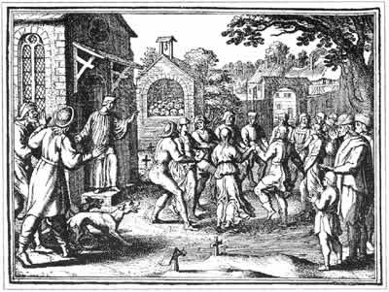
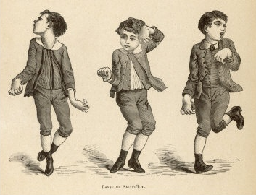
CHOREA
Syndenham chorea, St Vitus’ dance
5 – 36 % cases
Most common in females, rare > 20 yrs
Purposeless, involuntary, nonstereotypical movements of the trunk or extremities
Exacerbated by stress, relieved by sleep
Occasionally unilateral
St Vitus’ Dance

Slide 37
CHOREA
Long latent period
Do not cause permanent neurological sequelae
Rheumatic chorea – marker of future carditis
23% pure rheumatic chorea developed MS in 20 yrs follow-up
Chorea is rarely associated with polyarthritis
Inflammatory markers & ASO titres may be normal

Slide 38
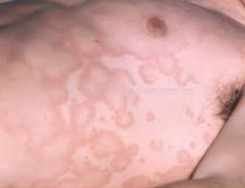
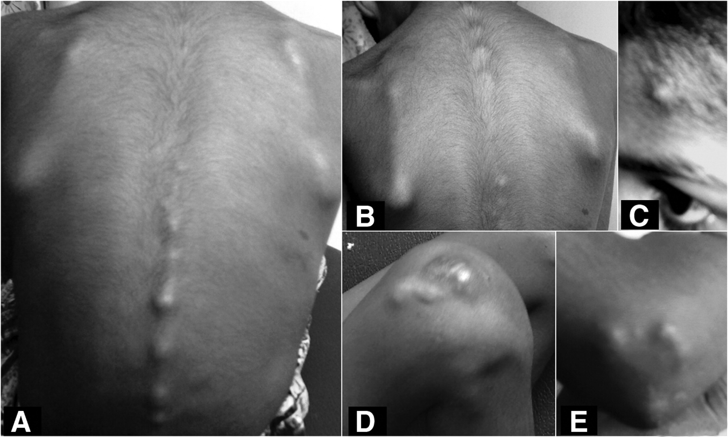
SKIN MANIFESTATIONS
Erythema marginatum
Subcutaneous
nodules

Slide 39
DIAGNOSIS OF ARF
Major criteria
Minor criteria
Essential criteria
Evidence of preceding GABHS infection
Initial RF: 2 major / 1major + 2 minor
Recurrent RF: 2 Major/ 1 major + 2 minor / 3 minor
Notes:
39

Slide 40
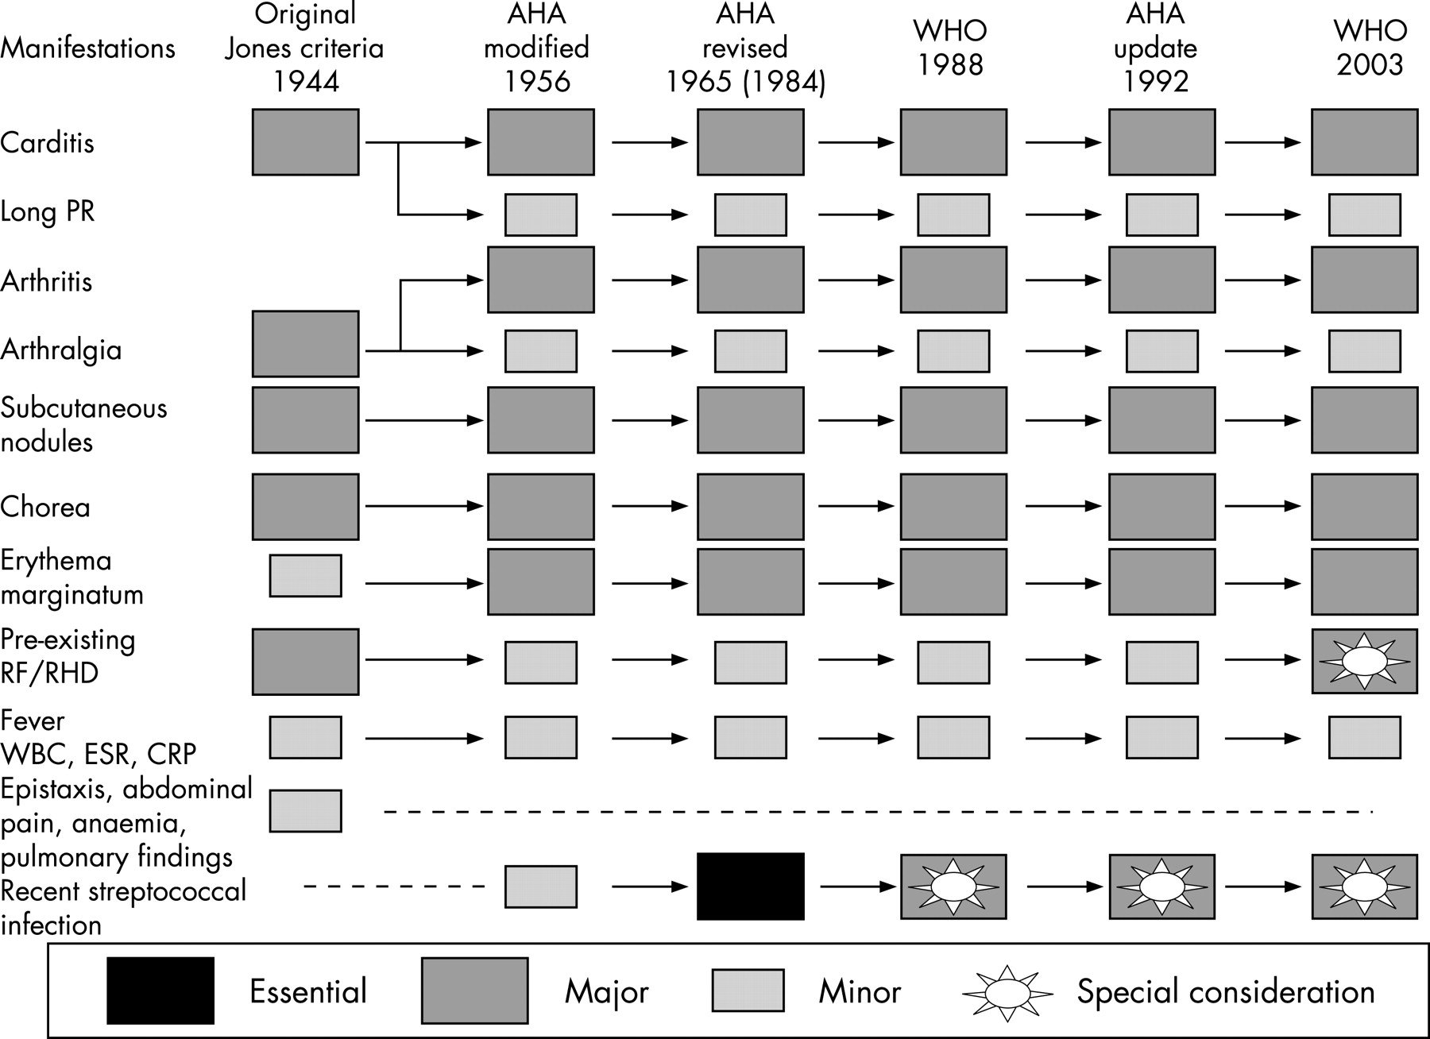
DIAGNOSIS OF ARF - EVOLUTION
Notes:
40

Slide 41
2015 UPDATE – DIAGNOSIS OF ARF
MAJOR – MINOR CRITERIA REVISION
Risk stratification:
LOW RISK population
Prevalence: ARF ≤ 2/100,000 school children
RHD < 1/1000 (all ages)
Non-low risk: Considered as HIGH/MODERATE risk
High sensitivity and High specificity
Notes:
41

Slide 42
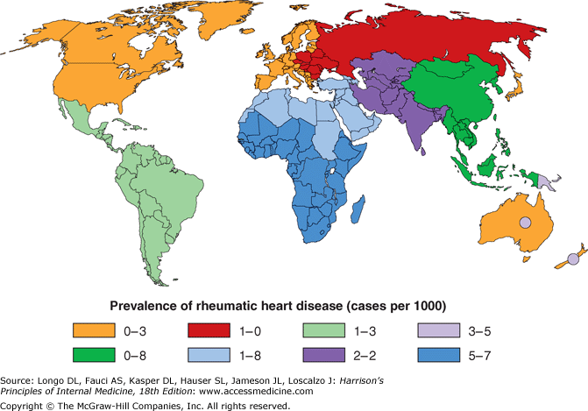
RHD – WORLDWIDE PREVALENCE
Notes:
42

Slide 43
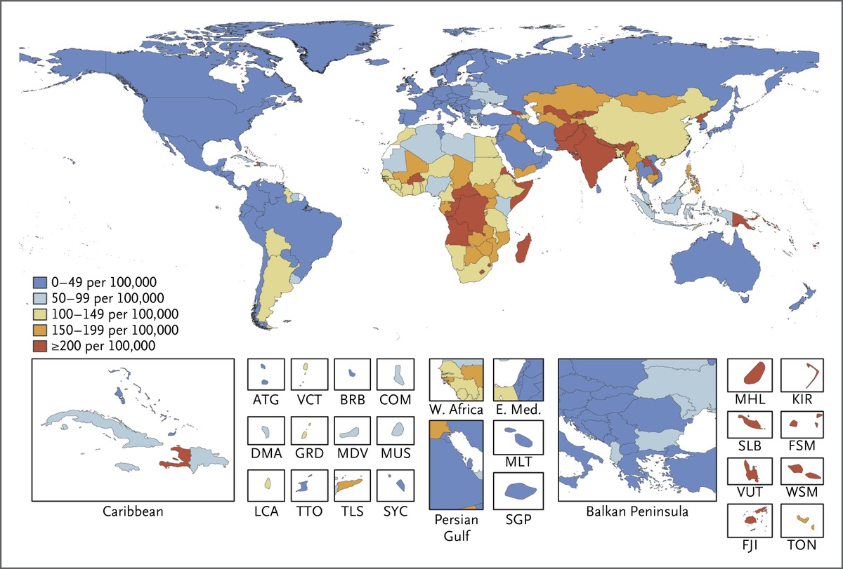
RHD – WORLDWIDE PREVALENCE
Global, regional, national burden of RHD 1990-2015, NEJM 2017
Notes:
43

Slide 44
PREVALENCE OF RHD – ICMR DATA
Year | No of children | No of centres | Prevalence
1972-75 | 1,33,000 | 5 | 5.3/1000
1984-87 | 53,786 | 3 | 2.9/1000
2007-2010 | 1,76,904 | 10 | 0.9/1000
Forty year study: 5.3/1000 to 0.9/1000
Notes:
44

Slide 45
PREVALENCE OF RHD
RURAL SCHOOL CHILDREN – INDIA
CLINICAL-ECHO STUDY
School children (6-18 years) at Vellore
229,829 children
Clinical: 374 – suspected RHD (1.63/1000)
Echo study: 157 RHD (0.67/1000)
Jose et al IHJ 2003. 55:158-60.
Notes:
45

Slide 46
ARF DIAGNOSIS
Essential criteria NOT required if:
Chorea – Late presentation
Indolent carditis – Late recognition
Notes:
46

Slide 47
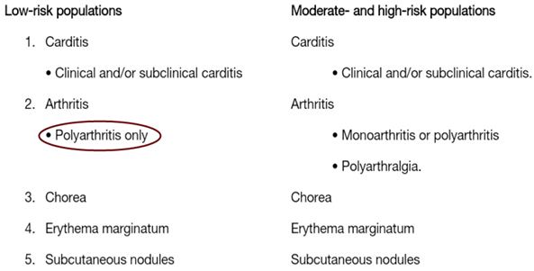
2015 UPDATE – DIAGNOSIS OF ARF
2015 AHA Update to Jones Criteria for diagnosis of RF. Circ 2015
Notes:
47

Slide 48
2015 UPDATE – DIAGNOSIS OF ARF
2015 AHA Update to Jones Criteria for diagnosis of RF. Circ 2015
Notes:
48

Slide 49
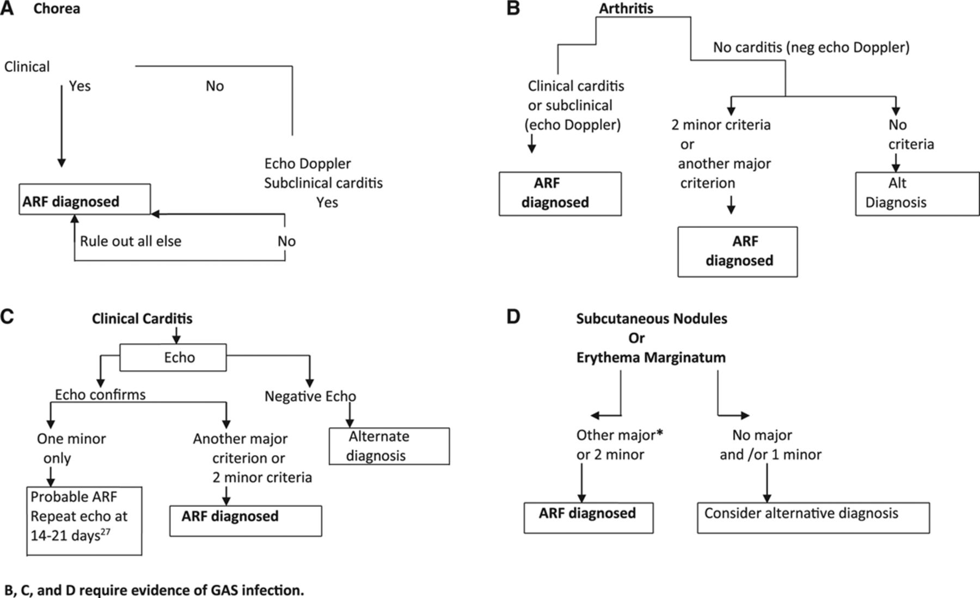
2015 UPDATE – DIAGNOSIS OF ARF
2015 AHA Update to Jones Criteria for diagnosis of RF. Circ 2015
Notes:
49

Slide 50
“POSSIBLE” RHEUMATIC FEVER
Clinical presentation may not fulfill the updated Jones criteria, but the clinician may still have good reason to suspect ARF
High-incidence settings → use clinical judgement
AHA 2015 Guideline:
“…. genuine uncertainty, it is reasonable to consider offering 12 months of secondary prophylaxis followed by reevaluation … include…. history and physical examination in addition to a repeat echocardiogram.”
(Class IIa; LOE: C)

Slide 51
STREPTOCOCCAL PHARYNGITIS
Sore throat
80% viral
20% bacterial
GABHS infection
Higher in children
Older than 45 years : Rare
Notes:
51

Slide 52
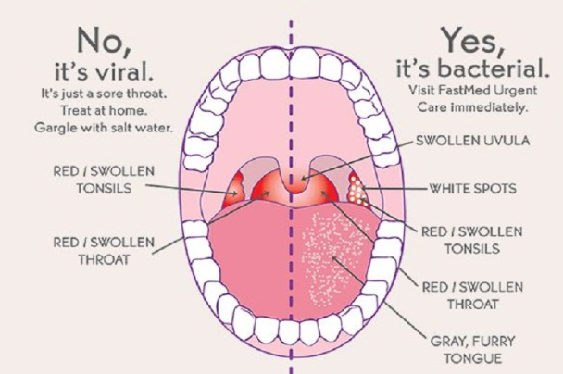
STREPTOCOCCAL PHARYNGITIS
Notes:
52

Slide 53
CLINICAL SCORE - PHARYNGITIS
Confined to Pharynx (absence of cough/coryza)
Local signs of inflammation
Tonsillar enlargement ++
Exudate +
Enlarged lymph nodes (anterior cervical LN)
Age 3-14 years
Score ≥ 2 → Rapid antigen test/Throat swab
Therapy: Specific
Symptomatic – Pain relief/Antipyretic
Notes:
53

Slide 54
STREP THROAT - TREATMENT
Drug | Duration | Dose
Penicillin (Benzathine Penicillin) | ONE Injection | 1.2 million units IM
Penicillin - V | 10 days | 250 mg BD (child) 500mg BD (adult)
Amoxicillin | 10 days | 500 mg TID or 775 mg OD
Notes:
54

Slide 55
STREP THROAT – TREATMENT
IF ALLERGIC TO PENICILLIN
Drug | Duration | Dose
Cephalexin | 10 days | 500 mg BD
Azithromycin | 5 days | 500 mg OD
Erythromycin | 10 days | 250 mg BD
Clarithromycin | 10 days | 250 mg BD
Clindamycin | 10 days | 600 mg BD
Notes:
55

Slide 56
NATURAL HISTORY - RF
Without secondary prophylaxis, recurrence is maximum in first five years and minimal beyond 15 years.
< 5 years : 20%
5 – 10 years : 10%
10 – 15 years : 5%
> 15 years : 2%
Duration of secondary prophylaxis depends on:
Presence of carditis during initial attack of RF
Age of patient – infrequent > 45 yrs
Severity of valve disease
Duration after last episode of RF
Notes:
56

Slide 57
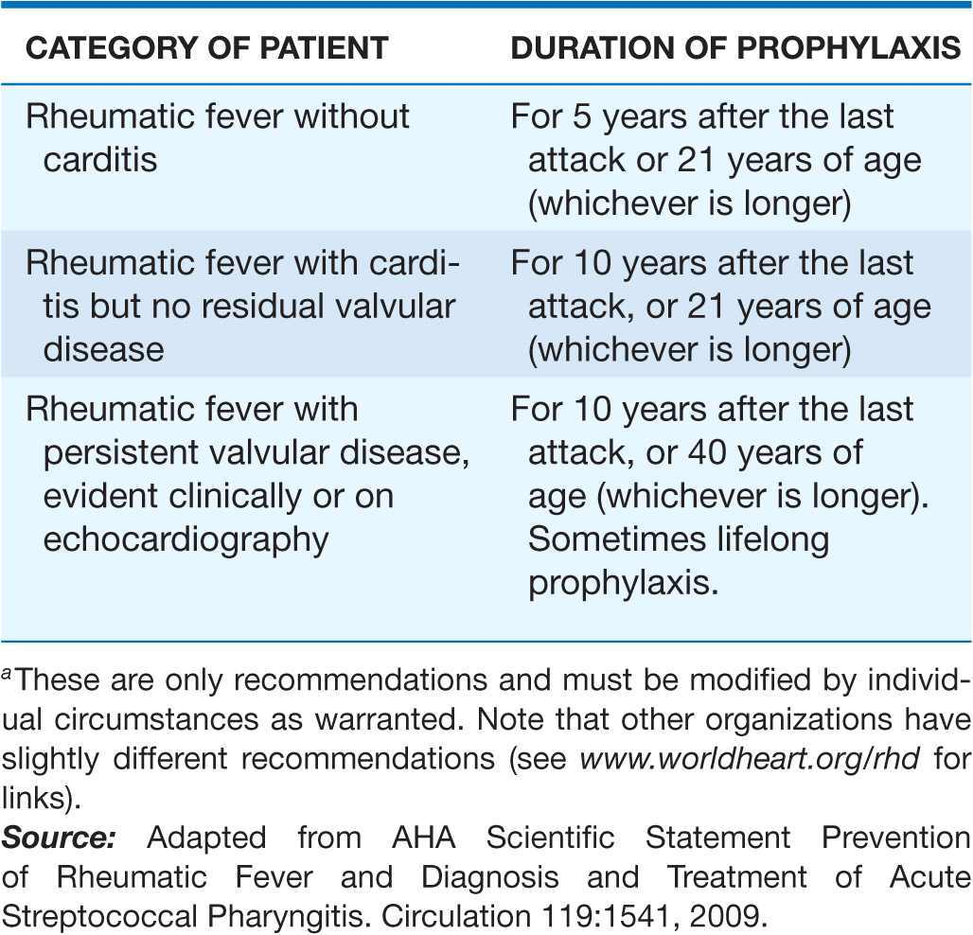
DURATION OF SECONDARY PROPHYLAXIS
** Severe Valvular disease/Post valve surgery → Lifelong
Notes:
57

Slide 58
RF – RECURRENCE DESPITE PROPHYLAXIS
Notes:
58

Slide 59
RF – RECURRENCE DESPITE PROPHYLAXIS
Notes:
59

Slide 60
THANK YOU!

